Slide 1
WELCOME

Slide 2
TEAM DETAILS
CAR RESALE VALUE PREDICTION
Team ID : PNT2022TMID31986
Team Members : 4
Team Leader : MANORANJITH G
Team member 1 : ASHWIN M
Team member 2 : MOHANAPRASATH M
Team member 3 : PRABHU M

Slide 3
PROBLEM STATEMENT
The prices of new cars in the industry is fixed by the manufacturer with some additional costs incurred by the Government in the form of taxes. So customers buying a new car can be assured of the money they invest to be worthy. But due to the increased price of new cars and the incapability of customers to buy new cars due to the lack of funds, used cars sales are on a global increase. Predicting the prices of used cars is an interesting and much-needed problem to be addressed. Customers can be widely exploited by fixing unrealistic prices for the used cars and many falls into this trap. Therefore, rises an absolute necessity of a used car price prediction system to effectively determine the worthiness of the car using a variety of features. Due to the adverse pricing of cars and the nomadic nature of people in developed countries, the cars are mostly bought on a lease basis, where there is an agreement between the buyer and seller. These cars upon completion of the agreement are resold. So reselling has become an essential part of today’s world.

Slide 4
The main aim of this project is to predict the price of used cars using the various Machine Learning (ML) models. This can enable the customers to make decisions based on different inputs or factors namely Brand or Type of the car one prefers like Ford, Hyundai.
Model of the car namely Ford Figo, Hyundai Creta, Year of manufacturing like 2020, 2021, Type of fuel namely Petrol, Diesel, Price range or Budget, Type of transmission which the customer prefers like Automatic or Manual, Mileage to name a few characteristic features required by the customer. This project Car Price Prediction deals with providing the solution to these problems. Different techniques like multiple linear regression analysis, k-nearest neighbours, naïve baye sand decision trees have been used to make the predictions. The predictions are then evaluated and compared in order to find those which provide the best performances.

Slide 5
Proposed solution
There are two primary phases in the system:
1 .Training phase : The system is trained by using the data int data set and fits a model(line/model)
based of the algorithm chosen accordingly.
2. Testing phase: The system is provided with the inputs and is tested for its working. The accuracy is checked. And therefore, the data that is used to train the model or test it, has to be appropriate. The system is designed to detect and predict price of used car and hence appropriate algorithms must be used to do the two different tasks. Before the algorithms are selected for further use, different algorithms were compared for its accuracy. The well-suited one for the task was chosen.

Slide 6
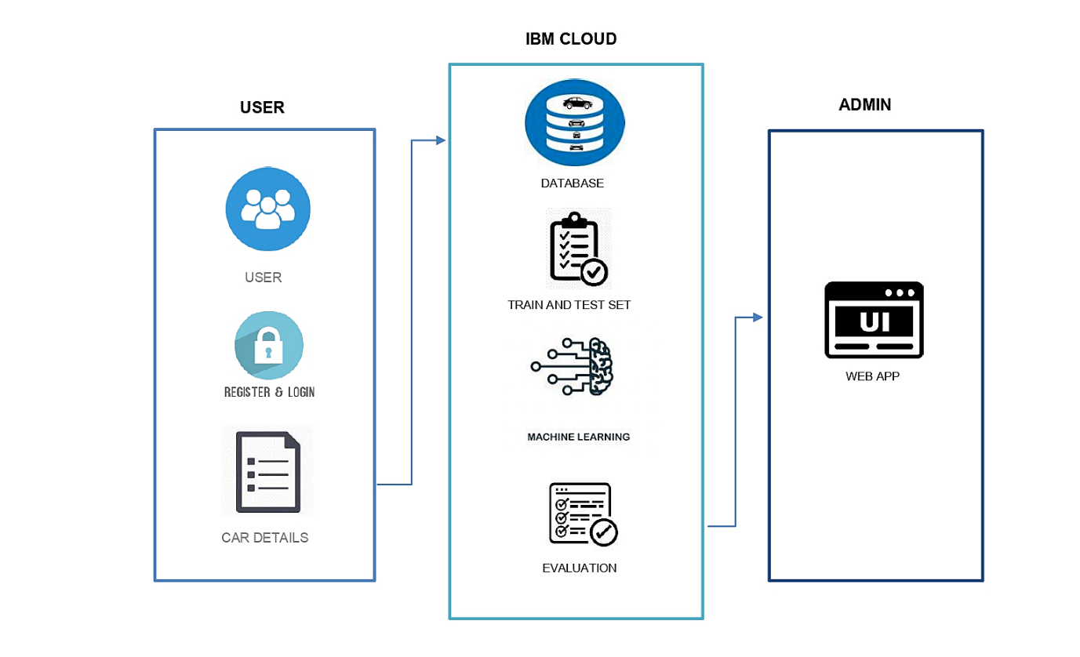
TECHNICAL ARCHITECTURE

Slide 7
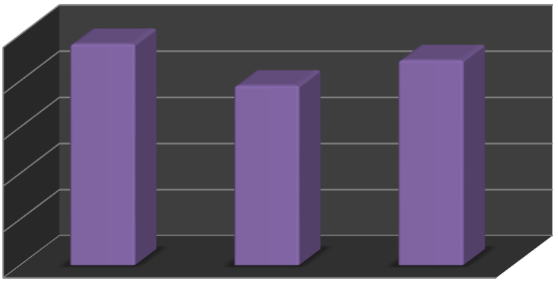
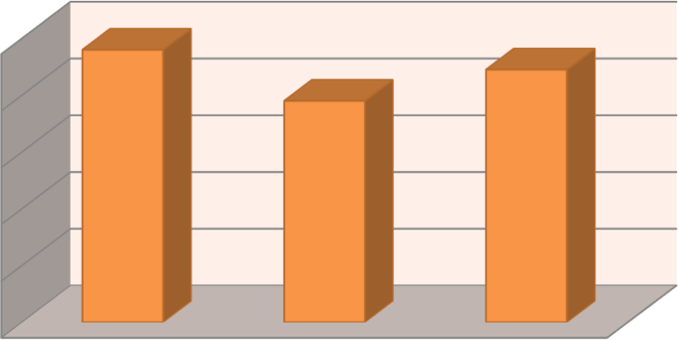
PERFORMANCE METRICS
EXISTING SYSTEM
PROPOSED SYSTEM
Random Forest Algorithm
Ridge Regression Algorithm
100
80
60
40
20
0
100
80
60
40
20
0
Accuracy Level
Precision Value
F1 Score
Accuracy Level
Precision Value
F1 Score

Slide 8
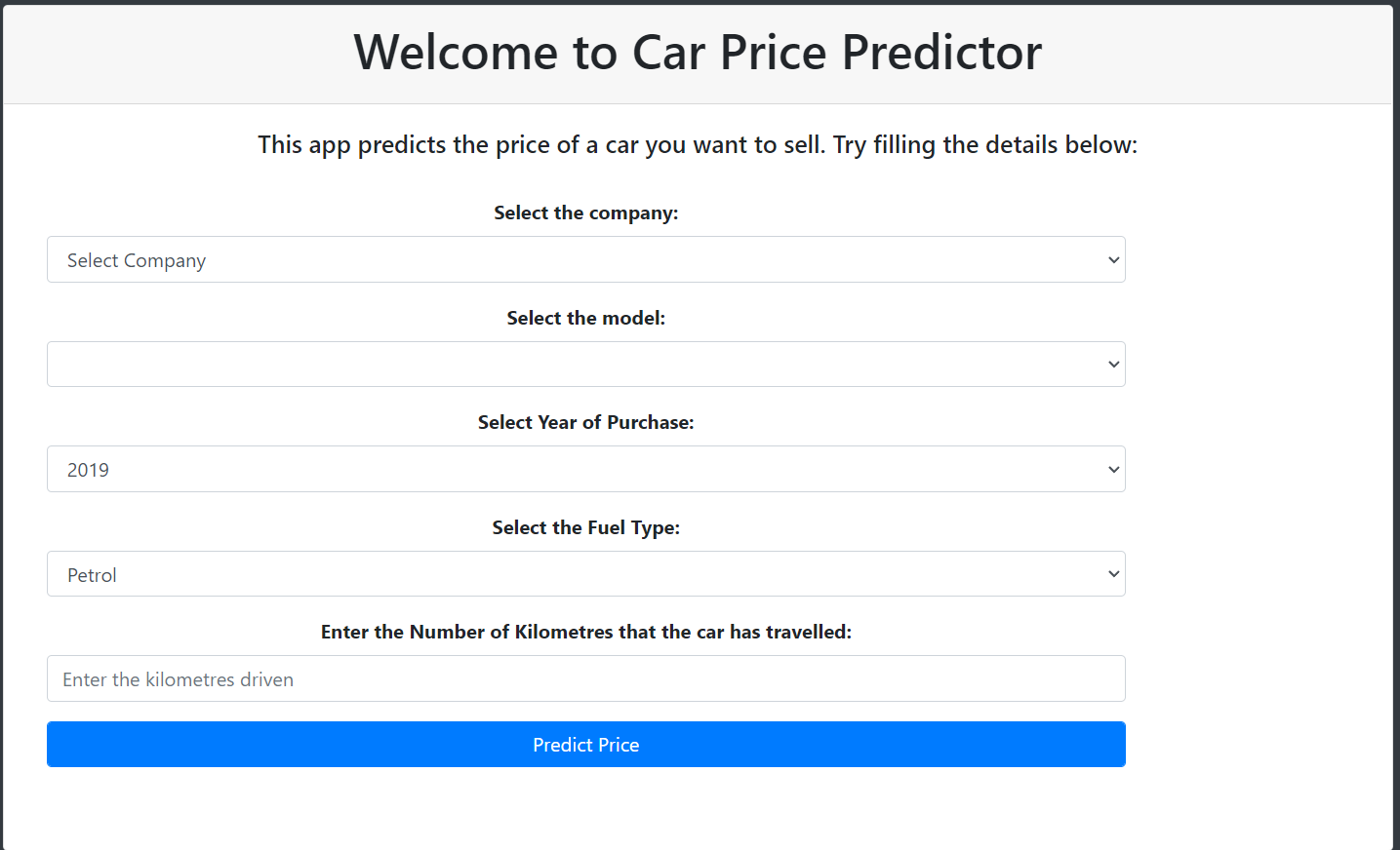

Slide 9
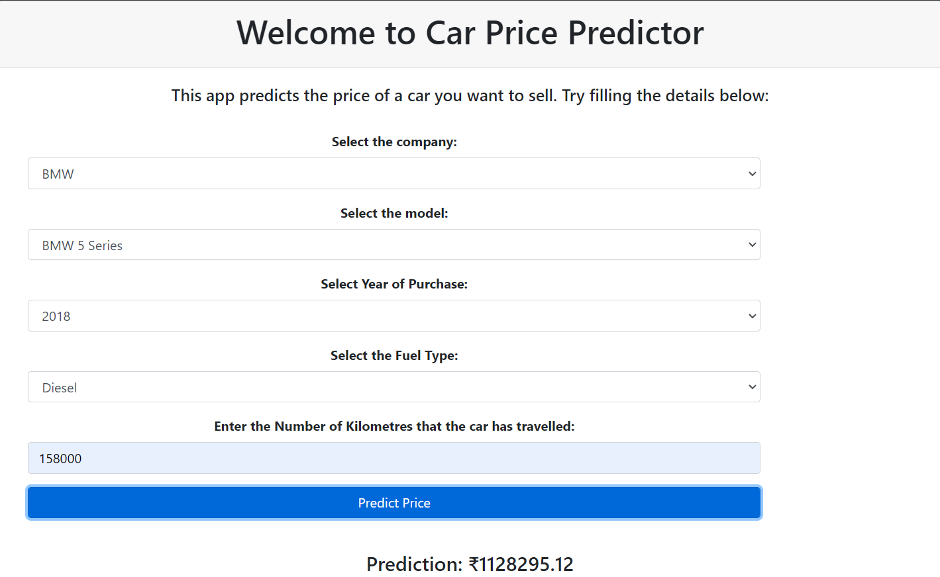

Slide 10
FUTURE SCOPE
In the future, more data will be collected using different web-scraping techniques, and deep learning classifiers will be tested. Algorithms like Quantile Regression, ANN and SVM will be tested. Afterwards, the intelligent model will be integrated with web and mobile-based applications for public use. Moreover, after the data collection phase Semiconductor shortages have incurred after the pandemic which led to an increase in car prices, and greatly affected the secondhand market. Hence having a regular Data collection and analysis is required periodically, ideally, we would be having a real time processing program.

Slide 11
THANK YOU

